Slide 1
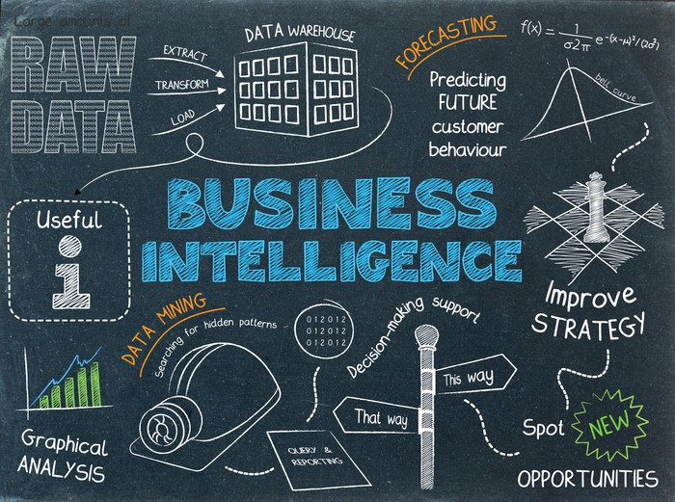
UECS3213 / UECS3453 Data Mining Topic 1: Introduction to Data Mining
Dr. Simon Lau Boung Yew

Slide 2
Course Learning Outcomes
CO1: Identify the key technological foundations of data mining
CO2: Create programming solutions using data mining techniques for given problem
CO3: Evaluate performance of data mining solutions for a given problem
CO4: Construct a data mining project as a team
CO5: Recognize the importance of data mining techniques and its applications in the industry

Slide 3
Outline
Overview of Data Science
What is data mining? What is not data mining?
DIKW Knowledge Pyramid
Terminologies
Data Mining
Data Science
Machine Learning
Data Analysis
Data Analytics
Big Data Analytics
Origin of data mining
Why data mining is important?
Data Mining Methods
Challenges of Data Mining
Data Mining Applications

Slide 4
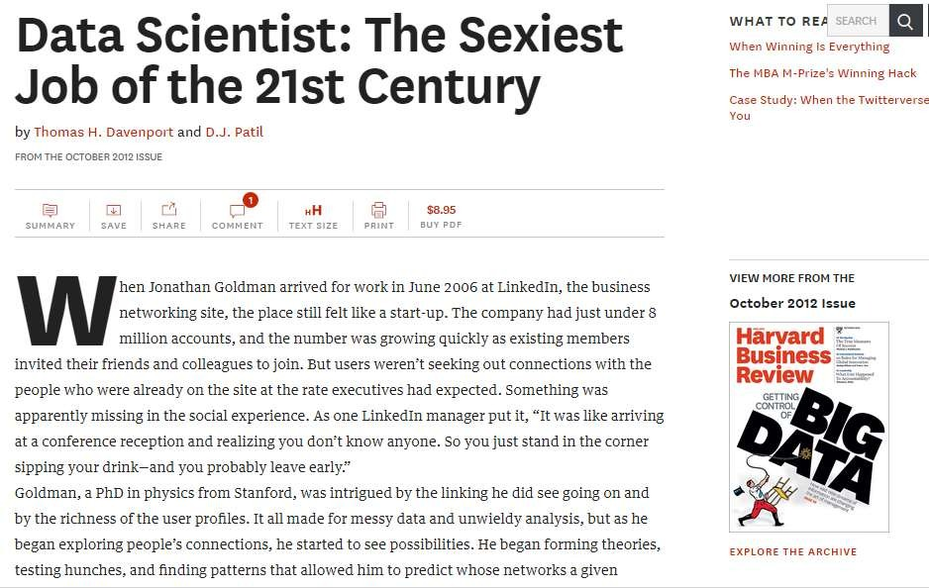
Harvard Business Review, Oct 2012
hbr.org/2012/10/data-scientist-the-sexiest-job-of-the-21st-century/

Slide 5
LinkedIn: The Most In-Demand Hard of 2018
Notes:
https://business.linkedin.com/talent-solutions/blog/trends-and-research/2018/the-most-in-demand-hard-and-soft-skills-of-2018

Slide 6
LinkedIn: The 25 Hottest Skills 2014
1 | Statistical Analysis and Data Mining | 14 | User Interface Design
2 | Middleware and Integration Software | 15 | Recruiting
3 | Storage Systems and Management | 16 | Digital and Online Marketing
4 | Network and Information Security | 17 | Computer Graphics and Animation
5 | SEO/SEM Marketing | 18 | Economics
6 | Business Intelligence | 19 | Java Development
7 | Mobile Development | 20 | Channel Marketing
8 | Web Architecture and Development Framework | 21 | SAP ERP Systems
9 | Algorithm Design | 22 | Integrated Circuit Design
10 | Perl/Python/Ruby | 23 | Shell Scripting Languages
11 | Data Engineering and Data Warehousing | 24 | Game Development
12 | Marketing Campaign Management | 25 | Virtualization
13 | Max, Linux and Unix Systems
http://talent.linkedin.com/blog/index.php/2014/12/...

Slide 7
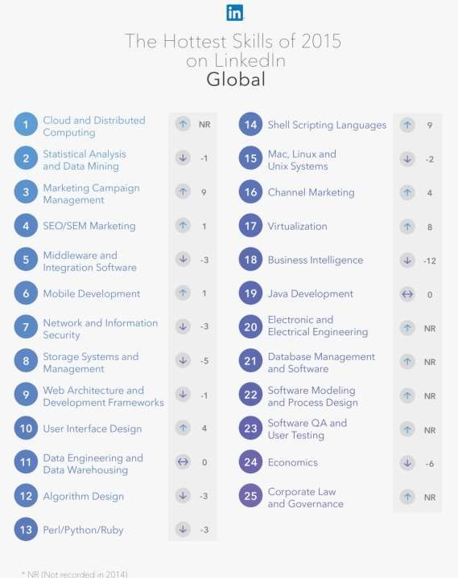

Slide 8
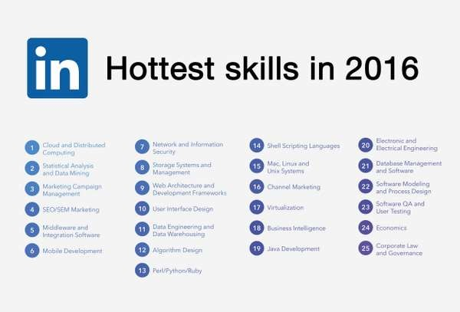

Slide 9

Jeremy Howard on TEDxBrussels, Dec 2014
http://www.ted.com/talks/jeremy_howard_the_wonderful_and_terrifying_implications_of_computers_that_can_learn?language=en
Notes:
https://www.ted.com/talks/jeremy_howard_the_wonderful_and_terrifying_implications_of_computers_that_can_learn?language=en

Slide 10
What is data mining?
Non-trivial extraction of implicit, previously unknown and potentially useful information from data such as knowledge rules, constraints, and regularities from data (Knowledge Discovery in Databases (KDD), an Overview)
also known as “knowledge discovery”
Exploration & analysis, by automatic or semi-automatic means, of large quantities of data in order to discover meaningful patterns, trends or relationships
Ref: Tan, Steiner, Kumar, “Introduction to Data Mining”
Notes:
non-trivial = significant, important
W.Frawley and G.Piatetsky‐Shapiro and C.Matheus, Knowledge Discovery in Databases: An Overview. AI Magazine,
1992, 213‐228

Slide 11
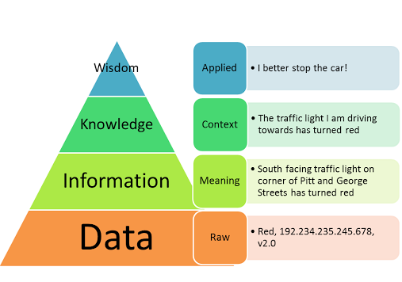
DIKW Knowledge Pyramid
Notes:
https://en.wikipedia.org/wiki/DIKW_pyramid

Slide 12
What is not data mining?
Look up phone number in phone directory
Query a Web search engine for information about “Amazon” (strictly just a keyword search with syntatic matching)
What can be considered data mining? For example...
Certain names are more prevalent in certain US locations (O’Brien, O’Rurke, O’Reilly... in Boston area)
Group together similar documents returned by search engine according to their context (e.g. Amazon rainforest, Amazon.com, etc.)

Slide 13
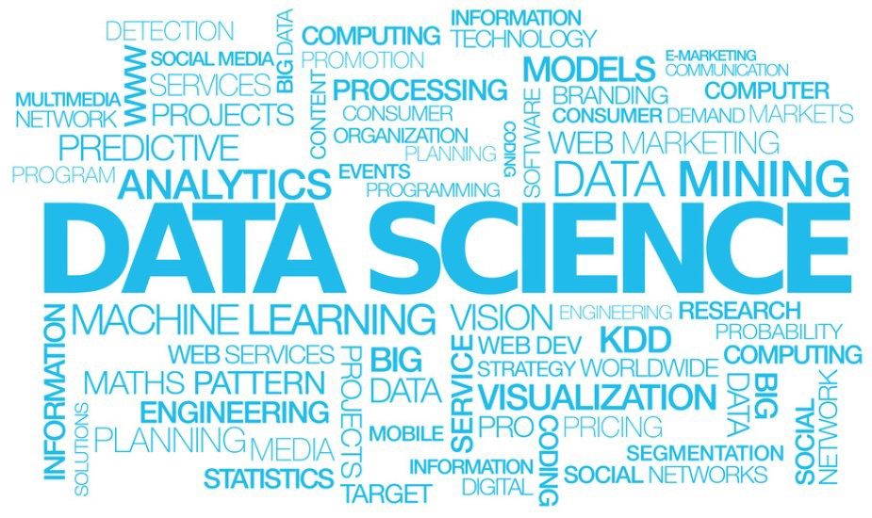
Terminologies

Slide 14
Terminologies
Data Science
An interdisciplinary field that uses scientific methods, processes, algorithms and systems to extract knowledge and insights from data in various forms, both structured and unstructured
Data Mining
Extract useful information (patterN) from huge data
Machine Learning
Computers’ ability to learn without explicit programming
Data Analytics
The process of examining data sets in order to draw conclusions about the information they contain.
Big Data Analytics
The process of analyzing larger data sets with the aim of uncovering useful information.
Predictive Analytics
analyze current and historical facts to make predictions
about future, or otherwise unknown, events.
Notes:
Data curation is the management of data throughout its lifecycle, from creation and initial storage to the time when it is archived for posterity or becomes obsolete and is deleted. The main purpose of data curation is to ensure that data is reliably retrievable for future research purposes or reuse.
https://www.datasciencecentral.com/profiles/blogs/difference-of-data-science-machine-learning-and-data-mining

Slide 15
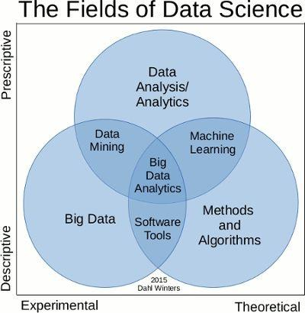
Terminologies

Slide 16
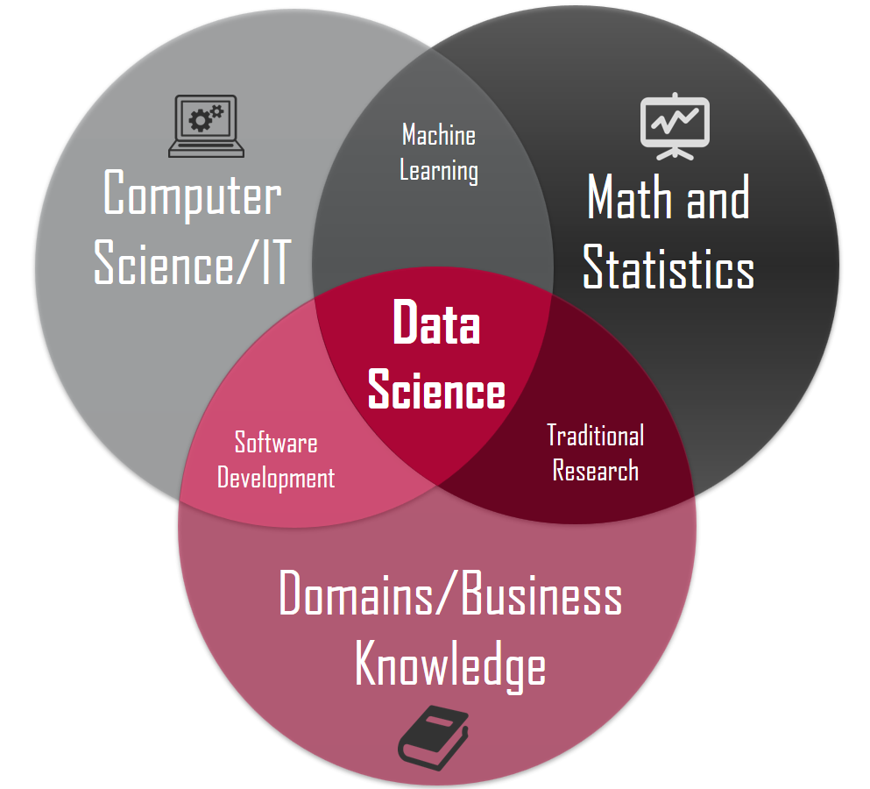
Data Science
Data science is an umbrella of several techniques that are used for extracting the information and the insights of data.
Data science is an interdisciplinary field that uses scientific methods, processes, algorithms and systems to extract knowledge and insights from data in various forms, both structured and unstructured.
It is a field that includes everything that is associated with the data cleansing, preparation and final analysis of data.
Data science combines the programming, logical reasoning, mathematics and statistics.
Notes:
https://en.wikipedia.org/wiki/Data_science
https://www.datasciencecentral.com/profiles/blogs/difference-of-data-science-machine-learning-and-data-mining

Slide 17
Data Mining
Data mining is a process (with a set of various methods) of knowledge discovery to extract information from various datasets for distinguishing the relationships and patterns that were previously unknown.
Data mining converts large sets of (raw) data into something more usable (new information, insights)

Slide 18
Machine Learning
Machine learning is kind of artificial intelligence that is responsible for providing computers the ability to learn about newer data sets without being programmed via an explicit source.
Machine learning is the science of creating algorithms and program which learn on their own when exposed to newer sets of data.
Once designed, they do not need a human to become better.

Slide 19
Data Analysis vs. Data Analytics
Data analysis is the process that involves the collection, manipulation (separating out a whole into parts) and examination (study the parts individually and their relationships with one another) of data. Data analysis looks backwards over time, with a historical view of what has happened.
Data analytics is the principle or method that drives logical analysis, the art of exploring the facts from the data with specific answer to specific questions. Data analytics look forward to model the future or predict a result.

Slide 20
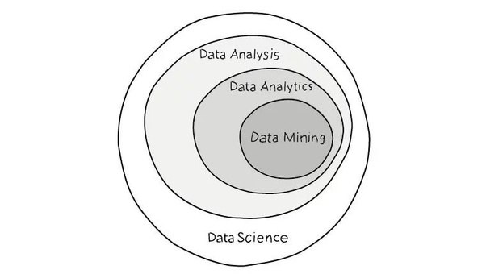

Slide 21
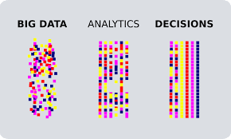
Big Data Analytics
Big data analytics is the complex process of examining large volumes of varied data sets -- or big data (gathered from a wide variety of sources, including social networks, videos, digital images, sensors, and sales transaction records) -- to uncover information including hidden patterns, unknown correlations, market trends and customer preferences that can help organizations make informed business decisions.
Notes:
https://searchbusinessanalytics.techtarget.com/definition/big-data-analytics

Slide 22
Predictive Analytics
Predictive analytics is a branch of the advanced analytics which is used to make predictions about unknown future events.
Predictive analytics uses techniques from data mining, statistics, modeling and machine learning to analyze current data to make predictions about the future.
The patterns found in historical and transactional data can be used to identify risks and opportunities for future.

Slide 23
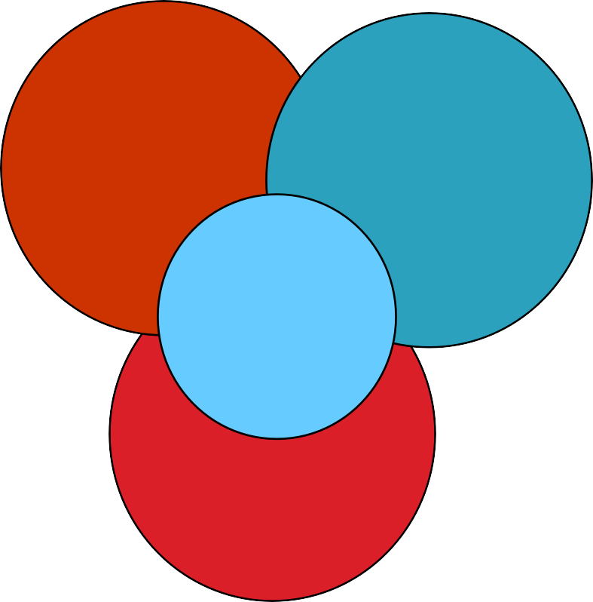
Origins of Data Mining
Draw ideas from machine learning / AI, pattern recognition, statistics, and database systems.
Traditional techniques may be unsuitable due to
Enormity (large volume) of data
High dimensionality of data
Heterogeneous, distributed nature of data
Statistics/ AI
Machine Learning/
Pattern Recognition
Data Mining
Database
systems
Notes:
dimensionality of data

Slide 24

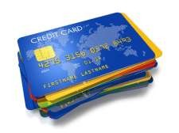

Why data mining is important?
Lots of data is being collected and archived
Web search, e.g. Google, Youtube
Social Networks, e.g. Facebook, Twitter
e-commerce, e.g. Amazon, Lazada, iTune
Purchases at departmental/grocery stores
Video and audios, e.g. city councils, polices
M-wallter, e.g. Alipay, WechatPay, etc.
UTAR, e.g. profile of potential new potential market to target
Computers are more powerful, cheaper and ubiquitous

Slide 25
Data Mining Methods / Tasks
Prediction Methods:
Use some variables to predict unknown or future values of other variables.
Classification (Chapter 3)
Regression (Chapter 4)
Deviation/Anomaly Detection (Chapter 5)
Description Methods:
Find human-interpretable patterns that describe the data.
Clustering (Chapter 5)
Associate Rules Discovery / Learning (Chapter 6)
Sequential Pattern Mining (Chapter 6)
Notes:
https://en.wikipedia.org/wiki/Association_rule_learning - Association rule learning is a rule-based machine learning method for discovering interesting relations between variables in large databases.
https://en.wikipedia.org/wiki/Sequential_pattern_mining - Sequential pattern mining is a topic of data mining concerned with finding statistically relevant patterns between data examples where the values are delivered in a sequence.
https://en.wikipedia.org/wiki/Anomaly_detection - In data mining, anomaly detection (also outlier detection) is the identification of rare items, events or observations which raise suspicions by differing significantly from the majority of the data.

Slide 26
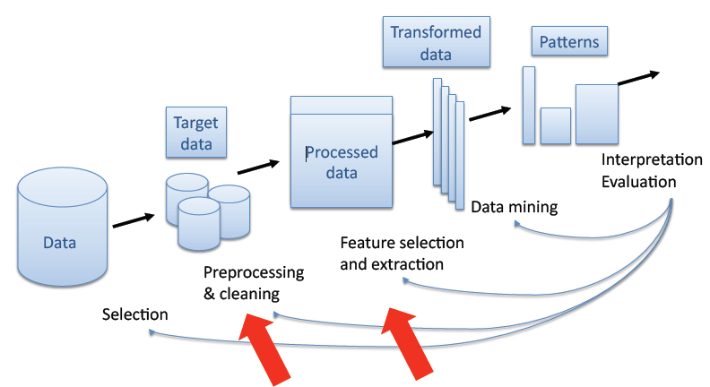
Feature Selection, Dimensionality Reduction, and Clustering in the KDD Process
U.M.Fayyad, G.Patetsky-Shapiro and P.Smyth (1995)

Slide 27
Data Mining Methods / Tasks
Classification – looking for unknown pattern in data.
Regression - predict a value of a given continuous valued variable based on the values of other variables
Clustering – discovering and documenting groups of facts which were not known.
Association – looking for patterns where events are connected.
Sequence or path analysis – looking for one event which leads to another event later.
Forecasting – finding data patterns which can lead to reasonable future predictions.

Slide 28
Common Data Mining tasks

Slide 29
Classification
Usually, the given data set is divided into training and test sets, with training set used to build the model and test set used to validate it.
Given a collection of records (training set), each record contains a set of attributes, one of the attributes is the class.
Find a model for class attribute as a function of the values of other attributes.
Goal: previously unseen records should be assigned a class as accurately as possible.
A test set is used to determine the accuracy of the model.

Slide 30

Classification: Example
Tid | Refund | Marital Status | Taxable Income | Cheat
1 | Yes | Single | 125K | No
2 | No | Married | 100K | No
3 | No | Single | 70K | No
4 | Yes | Married | 120K | No
5 | No | Divorced | 95K | Yes
6 | No | Married | 60K | No
7 | Yes | Divorced | 220K | No
8 | No | Single | 85K | Yes
9 | No | Married | 75K | No
10 | No | Single | 90K | Yes
Refund | Marital Status | Taxable Income | Cheat
No | Single | 75K | ?
Yes | Married | 50K | ?
No | Married | 150K | ?
Yes | Divorced | 90K | ?
No | Single | 40K | ?
No | Married | 80K | ?
Training Set
Test Set
10
Test Set
Learn
Classifier
Training
Set
Model
10

Slide 31
Classification: Application 1
Direct Marketing
Goal: Reduce cost of mailing by targeting a set of consumers likely to buy a new cell-phone product.
Approach:
Use the data for a similar product introduced before.
We know which customers decided to buy and which decided otherwise. This {buy, don’t buy} decision forms the class attribute.
Collect various demographic, lifestyle, and company- interaction related information about all such customers, type of business, where they stay, how much they earn, etc.
Use this information as input attributes to learn a classifier model.

Slide 32
Classification: Application 2
Customer Attrition/Churn
Goal: To predict whether a customer is likely to be lost to a competitor.
Approach:
Use detailed record of transactions with each of the past and present customers, to find attributes.
How often the customer calls, where he calls, what time-of-the day he calls most, his financial status, marital status, etc.
Label the customers as loyal or disloyal (class).
Find a model for loyalty.
Notes:
https://en.wikipedia.org/wiki/Customer_attrition - Customer attrition, also known as customer churn, customer turnover, or customer defection, is the loss of clients or customers.

Slide 33
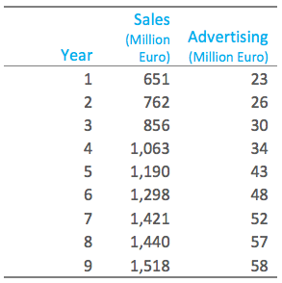
Regression
Predict a value of a given continuous valued variable based on the values of other variables, assuming a linear or nonlinear model of dependency.
Examples:
Predicting sales amounts of new product based on advetising expenditure.
Predicting wind velocities as a function of temperature, humidity, air pressure, etc.
Time series prediction of stock market indices.

Slide 34
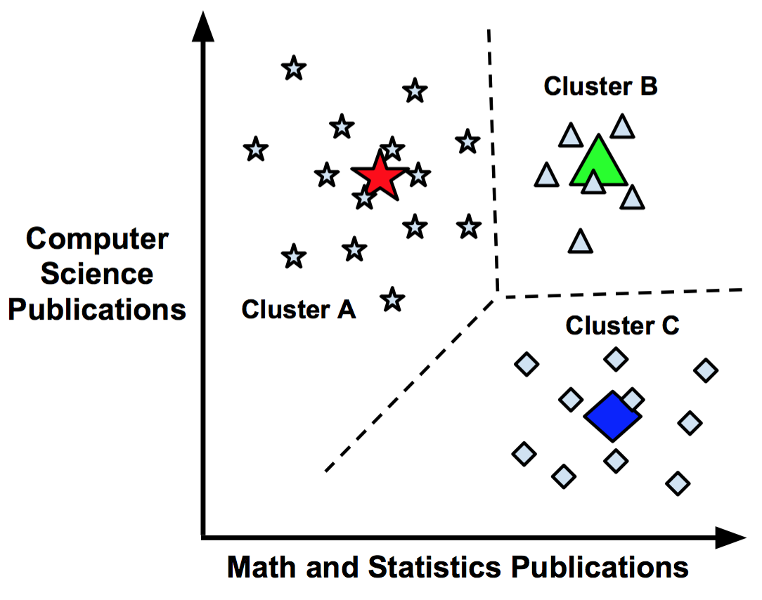
Clustering
Given a set of data points, each having a set of attributes, and a similarity measure among them, find clusters such that data points in one cluster are more similar to one another.
Data points in separate clusters are less similar to one another.
Similarity measures, e.g.
Euclidean Distance, if attributes are continuous.
Other problem-specific measures.

Slide 35
Clustering: Application 1
Market Segmentation
Goal: subdivide a market into distinct subsets of customers where any subset may conceivably be selected as a market target to be reached with a distinct marketing mix.
Approach:
Collect different attributes of customers based on their geographical and lifestyle related information (attributes).
Find clusters of similar customers.
Measure the clustering quality by observing buying patterns of customers in the same cluster vs. those from different clusters.

Slide 36
Clustering: Application 2
Document Clustering
Goal: To find groups of documents that are similar to each other based on the important terms appearing in them.
Approach:
To identify frequently occurring terms in each document.
Form a similarity measure based on the frequencies of different terms. Use it to cluster.
Gain: Information retrieval can utilize the clusters to relate a new document or search term to clustered documents.

Slide 37
Association Rule Discovery
Given a set of records each of which contain some number of items from a given collection
Produce dependency rules which will predict occurrence of an item based on occurrences of other items.
TID | Items
1 | Bread, Coke, Milk
2 | Beer, Bread
3 | Beer, Coke, Diaper, Milk
4 | Beer, Bread, Diaper, Milk
5 | Coke, Diaper, Milk
Rules Discovered:
{Milk} --> {Coke}
{Diaper, Milk} --> {Beer}

Slide 38
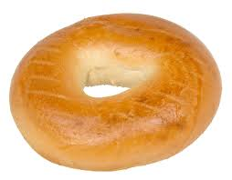
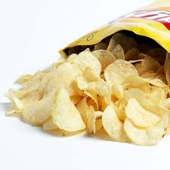
Association Rule Discovery: Application 1
Marketing and Sales Promotion
Let the rule discovered be {Bagels, … } --> {Potato Chips}
Potato Chips as consequent =>
Can be used to determine what should be done to boost its sales.
Bagels in the antecedent =>
Can be used to see which products would be affected if the store discontinues selling bagels.
Bagels in antecedent and Potato chips in consequent =>
Can be used to see what products should be sold with Bagels to promote sale of Potato chips!
Notes:
antecedent - a thing that existed before or logically precedes another.

Slide 39
Association Rule Discovery: Application 2
Supermarket shelf management
Goal: To identify items that are bought together by sufficiently many customers.
Approach:
Process the point-of-sale data collected with barcode scanners to find dependencies among items.
A classic rule --
If a customer buys diaper and milk, then he is very likely to buy beer.
So, don’t be surprised if you find six-packs stacked next to diapers!

Slide 40
Sequential Pattern Discovery / Mining
The task of sequential pattern discovery is a data mining task specialized for analyzing sequential data, to discover sequential patterns.
Given is a set of objects, with each object associated with its own timeline of events, find rules that predict strong sequential dependencies among different events.
Rules are formed by first discovering patterns.
Event occurrences in the patterns are governed by timing constraints.

Slide 41
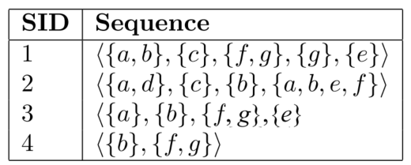
Sequential Pattern Discovery: Example
Consider the following sequence database, representing the purchases made by customers in a retail store.
This database contains four sequences.
Each sequence represents the items purchased by a customer at different times.
A sequence is an ordered list of itemsets (sets of items bought together). For example, in this database, the first sequence (SID 1) indicates that a customer bought some items a and b together, then purchased an item c, then purchased items f and g together, then purchased an item g, and then finally purchased an item e.
Sequential pattern discovery can be used to find the sequences of items frequently bought by customers. This can be useful to understand the behavior of customers to take marketing decisions.
Notes:
http://data-mining.philippe-fournier-viger.com/introduction-sequential-pattern-mining/

Slide 42
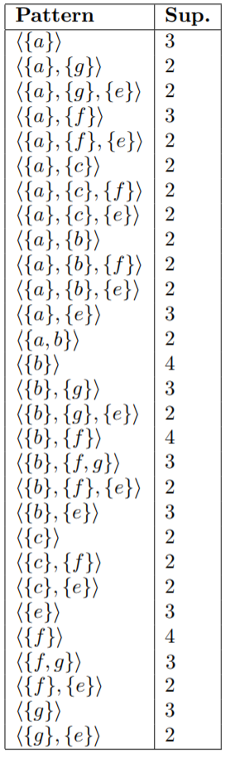
Sequential Pattern Discovery: Example
To do sequential pattern mining, a user must provide a sequence database and specify the minimum support threshold: a minimum number of sequences in which a pattern must appear to be considered frequent, and be shown to the user.
For example, if a user sets the minimum support threshold to 2 sequences, the task of sequential pattern mining consists of finding all subsequences appearing in at least 2 sequences of the input database. In the example database, 29 subsequences met this requirement.

Slide 43
Sequential Pattern Discovery: Applications
Customer shopping sequences:
First buy computer, then CD-ROM, and then digital camera, within 3 months.
Medical treatments, natural disasters (e.g., earthquakes), science & eng. processes, stocks and markets, etc.
Telephone calling patterns, Weblog click streams analysis
Bioinformatics: DNA sequences and gene structures

Slide 44
Deviation / Anomaly Detection
Detect significant deviations from normal behavior
Applications:
Credit Card Fraud Detection
Network Intrusion Detection (security)

Slide 45
Challenges of Data Mining
4Vs
Volume – Scale of data
Velocity – Analysis of streaming data
Variety – Different forms of data
Veracity – Uncertainty of data
Scalability
Dimensionality (# of features)
Complex and heterogeneous Data
Data quality
Data wwnership and distribution
Privacy preservation
Streaming data (volume & velocity)

Slide 46
Example Problems and Applications of Data Mining (1)
Handwritten address recognition
Video searching and indexing
Fraud detection (money laundering & other financial crimes)
Weather prediction
Facial recognition
Financial Data Analysis (Loan payment prediction and customer credit policy analysis)

Slide 47
Example Problems and Applications of Data Mining (2)
Retail Industry (targeted marketing, product recommendation)
Telecommunication Industry (fraudulent pattern analysis)
Bioinformatics (analysis of genetic networks and protein)
Intrusion Detection
Other Scientific Applications

Slide 48
Main References
Harrington, P (2012). Machine Learning in Action. Manning Publications.
Richert, W. and Coelho, L.P. (2013). Building Machine Learning Systems with Python. Packt Publishing.
Witten, I.H, Franck, E, and Hall, M. A. (2011). Data Mining: Practical Machine Learning Tools and Techniques. (3rd ed.). Morgan Kaufmann.
Pang-Ning Tan, Michael Steinbach, Anuj Karpatne, Vipin Kumar (2018). Introduction to Data Mining (2nd Edition), Pearson

Slide 49
Other References
J. Grus (2015). Data Science from Scratch: First Principles with Python. O'Reilly Media.
C. C. Aggarwal. (2015). Data Mining: The Textbook. Springer
Richert, W. and Coelho, L.P. (2013). Building Machine Learning Systems with Python. Packt Publishing.
Russel M.A. (2013). Mining the Social Web: Data Mining Facebook, Twitter, LinkedIn, Google+, GitHub, and More. (2nd Ed). O’Reilly Media.

